Slide 1

Agile presentation

Slide 2

AGILE ROLES
Product Owner
Defining and prioritizing the product backlog
Collaborates with stakeholders to gather requirements and understand the product vision
Works closely with the development team to clarify requirements and provide timely feedback
Scrum Master
Facilitates Scrum evets, such as daily stand-ups, sprint planning,, sprint reviews, and retrospectives
Guides the team on Scrum practices and helping them embrace the Agile mindset
Ensures that the team follows Scrum processes and continuously improves its effectiveness
Development Team
Collaborates with the Product Owner to understand and refine user stories
Is made of developers and testers
Participates in daily stand-ups and provides regular updates on progress
Collaborates with other team members to ensure a cohesive and high-quality product

Slide 3
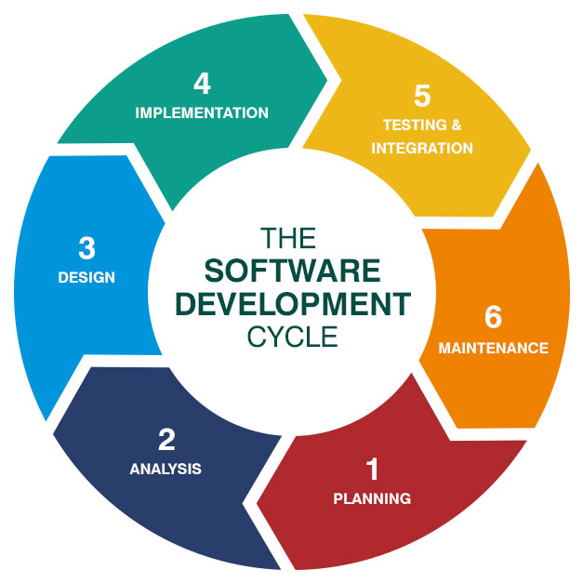
Software Development LifeCycle
Planning
User Story Collection
Collaborative Sprint Planning
Analysis
Analyze documents related to project
Assesses the client’s current environment or system
Design
Specify the technologies needed, limitations to consider, time frames for completion, and budgetary considerations
Implementation
Begin development
Iterative and incremental development approach
Testing & Integration
Identify and fix bugs and issues
Maintenance
Ensure client satisfaction
Offer general product maintenance
Address different issues that may come up w/ software product over time

Slide 4
Agile
vs
waterfall
Limited Collaboration Opportunities
Change Request Process
Revision of Design & Development Phases
Impact on Schedule & Budget
Immediate Collaboration
Iterative Improvement
Minimal Impact on Schedule

Slide 5
References
Datarob. “Software Development Life Cycle (SDLC) - Basics, Stages, Models.” Datarob, 20 Mar. 2020, datarob.com/essentials-software-development-life-cycle/.

